Slide 1
All About Landing Pages

Slide 2

PLAN
1)What is a landing Page
2)What do you use it for ?
3) 5 crucial things every landing page should have

Slide 3

What is a landing Page

Slide 4

ONE PAGE ONE PURPOSE
Landing page is a web page focused call to action either a sign up form or a button contests and coupons are also great types of landing pages

Slide 5
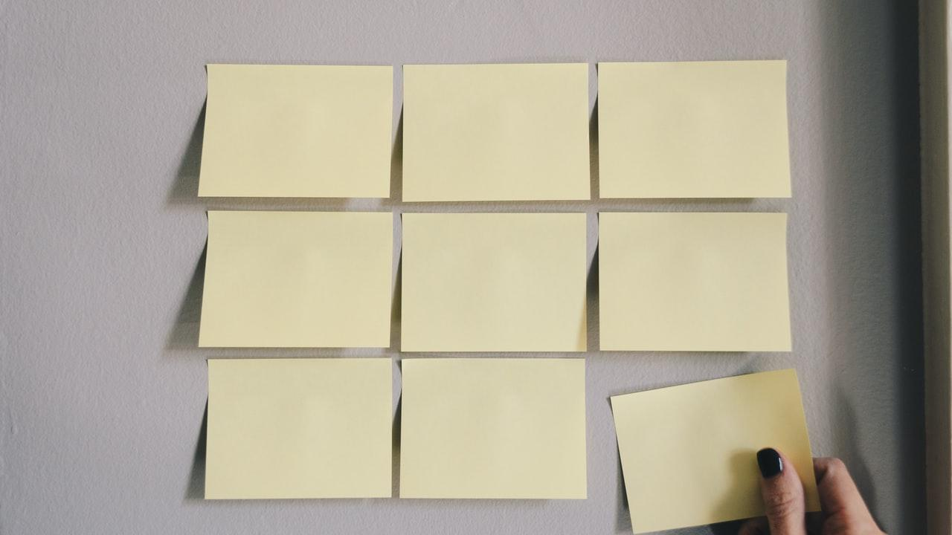
WHAT DO YOU USE IT FOR ?
Higher conversion rates
Increased engagement
Better quality leads
Notes:
A landing page take away any distractions that don’t directly point towards your conversion

Slide 6

5 crucial things every landing page should have
1) Have a VERY clear value proposition you have to explain to people what’s in it for them

Slide 7

2) have a strong call to action you need to tell them what to do
3) keep people focused by limiting distractions
4) use visuals effectively to explain what are they
going to get it would be great if that image can evoke emotion that would make them take actual actions
5) social proof ; show an example of other people using your service/product and their feedback

Slide 8
Some great examples of an effective Landing page

Slide 9

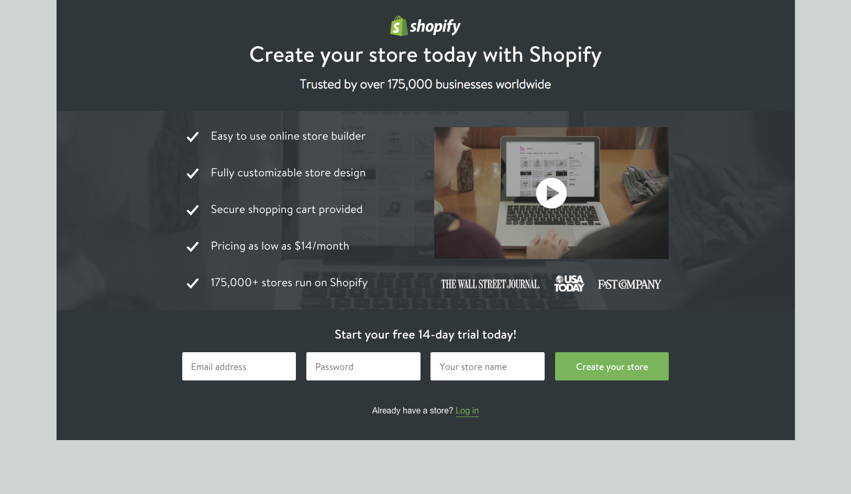
I

Slide 10
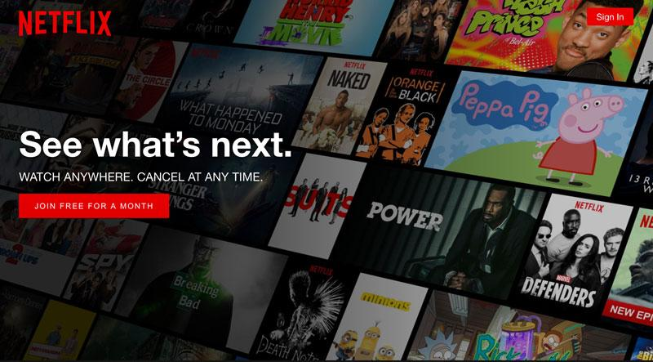
I

Slide 11
I

